Slide 1

Project 1: NBA Playoffs
Created by: Matt Macrides

Slide 2
Introduction
This is my first data science project that I’m documenting on GitHub
I wanted to start with a topic that I’m passionate about and has many implied correlations for my first project
Objectives
Better learn and understand modeling techniques
Build python functions that can help automate process for projects in the future
Compare average precision vs AUC

Slide 3

Data Source Extraction
Source: Basketball Reference
Extraction work was very simple. All I had to do was save the tables as .csv to my machine
I decided to extract these following seasons:
18-19
19-20
20-21
21-22
22-23

Slide 4
Data Prep
Created a list including all the seasons used in the program (ex. ‘21-22’)
Iterated through the list to read the csv files into a dataframe
Dropped unnecessary columns (ex. Dropped wins and losses because I had win percentage)
Create a Teams dataframe with only season and team variables to join on modeled data for reference
I decided to use the data prior to this year for training purposes and this year’s data for testing

Slide 5
Modeling

Slide 6
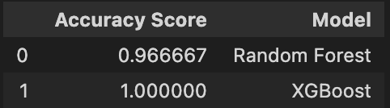
Predicting Playoffs: First Approach
My goal was to answer “How well can the model predict which NBA teams make the playoffs with the use of ALL variables”
All variables include Win percentage and point differential
Here are the accuracy scores ->

Slide 7
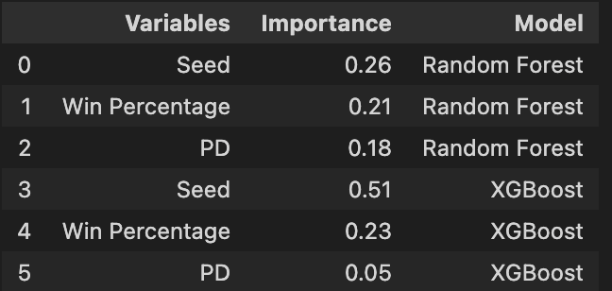
Predicting Playoffs: First Approach Continued
An accuracy score [0.93-1] is not surprising to me as the model was able to train on variables that have very strong correlations with Playoff chances like seed and win percentage
Here is the list of the top 3 feature importance where you can see that seed and win percentage were the highest features in each model

Slide 8
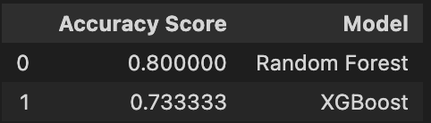
Predicting Playoffs: Second Approach
Now I wanted to ask, “How well can the models predict which NBA teams will make the playoffs based on secondary variables only
Secondary variables exclude Win percentage, PD, and seed because these directly influence whether a team will make the playoffs
Results

Slide 9
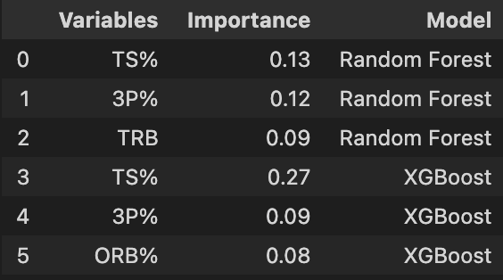
Predicting Playoffs: Second Approach Continued
It was impressive that the model recorded accuracies of 0.80 and 0.73 for RF and XGBoost respectively
The most indicative features are True Shooting % and 3P% for both models
This makes sense as the more accurate you are shooting, the more points you’d accumulate if the total shots taken was controlled

Slide 10
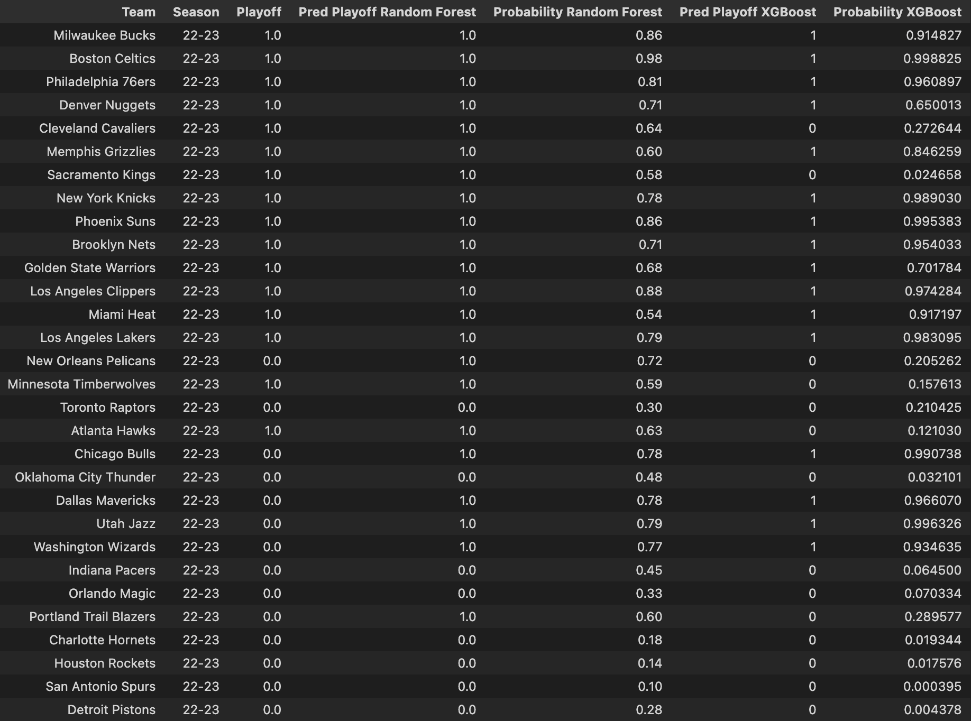
Continued
I have attached each team with the playoff actual, playoff predict per model, and playoff probability per model. Again, the RF was 80% accurate and XGBoost was 73%. It seems that both models assigned more 1’s than there were playoff teams

Slide 11
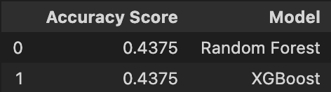
Predicting Quarter Finals|Playoffs = 1
Now I wanted to know, “How well can I predict which teams win the first round of the playoffs given that they made the playoffs?”
We will act like the playoffs are just about to start and will add back seed and win percentage in this model
Model was 44% accurate. What happened???

Slide 12
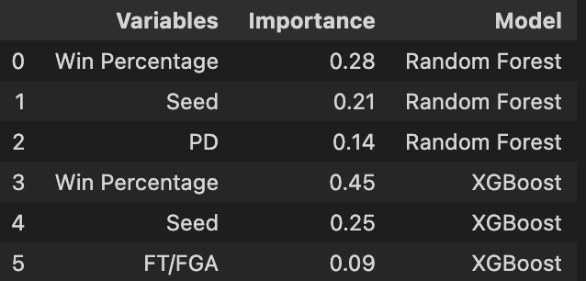
Predicting Quarter Finals
Ah, I see. The models most important features are win percentage and seed. This is a problem because 50% of the first round winners were upsets!
Now, let’s talk about some of this model’s limitations

Slide 13
Model Limitations
With a model that holds such a heavy weight on seeding, it will be tough to predict any upsets which is problematic because, this year, 50% of the first round winners were upsets
I am not segmenting my test/train variables on if the teams were in the east or west
I am running RF’s and Xgboosts as a whole and not on each specific matchup
The model doesn’t predict home vs. away games, how much rest between games, or if players are injured
The NBA is so dynamic that it’s hard to acquire all the data to make a very accurate model (Example: State of the art NBA 538 model predicted only half of the first round winners correct)

Slide 14
Interesting Correlations within the Data

Slide 15
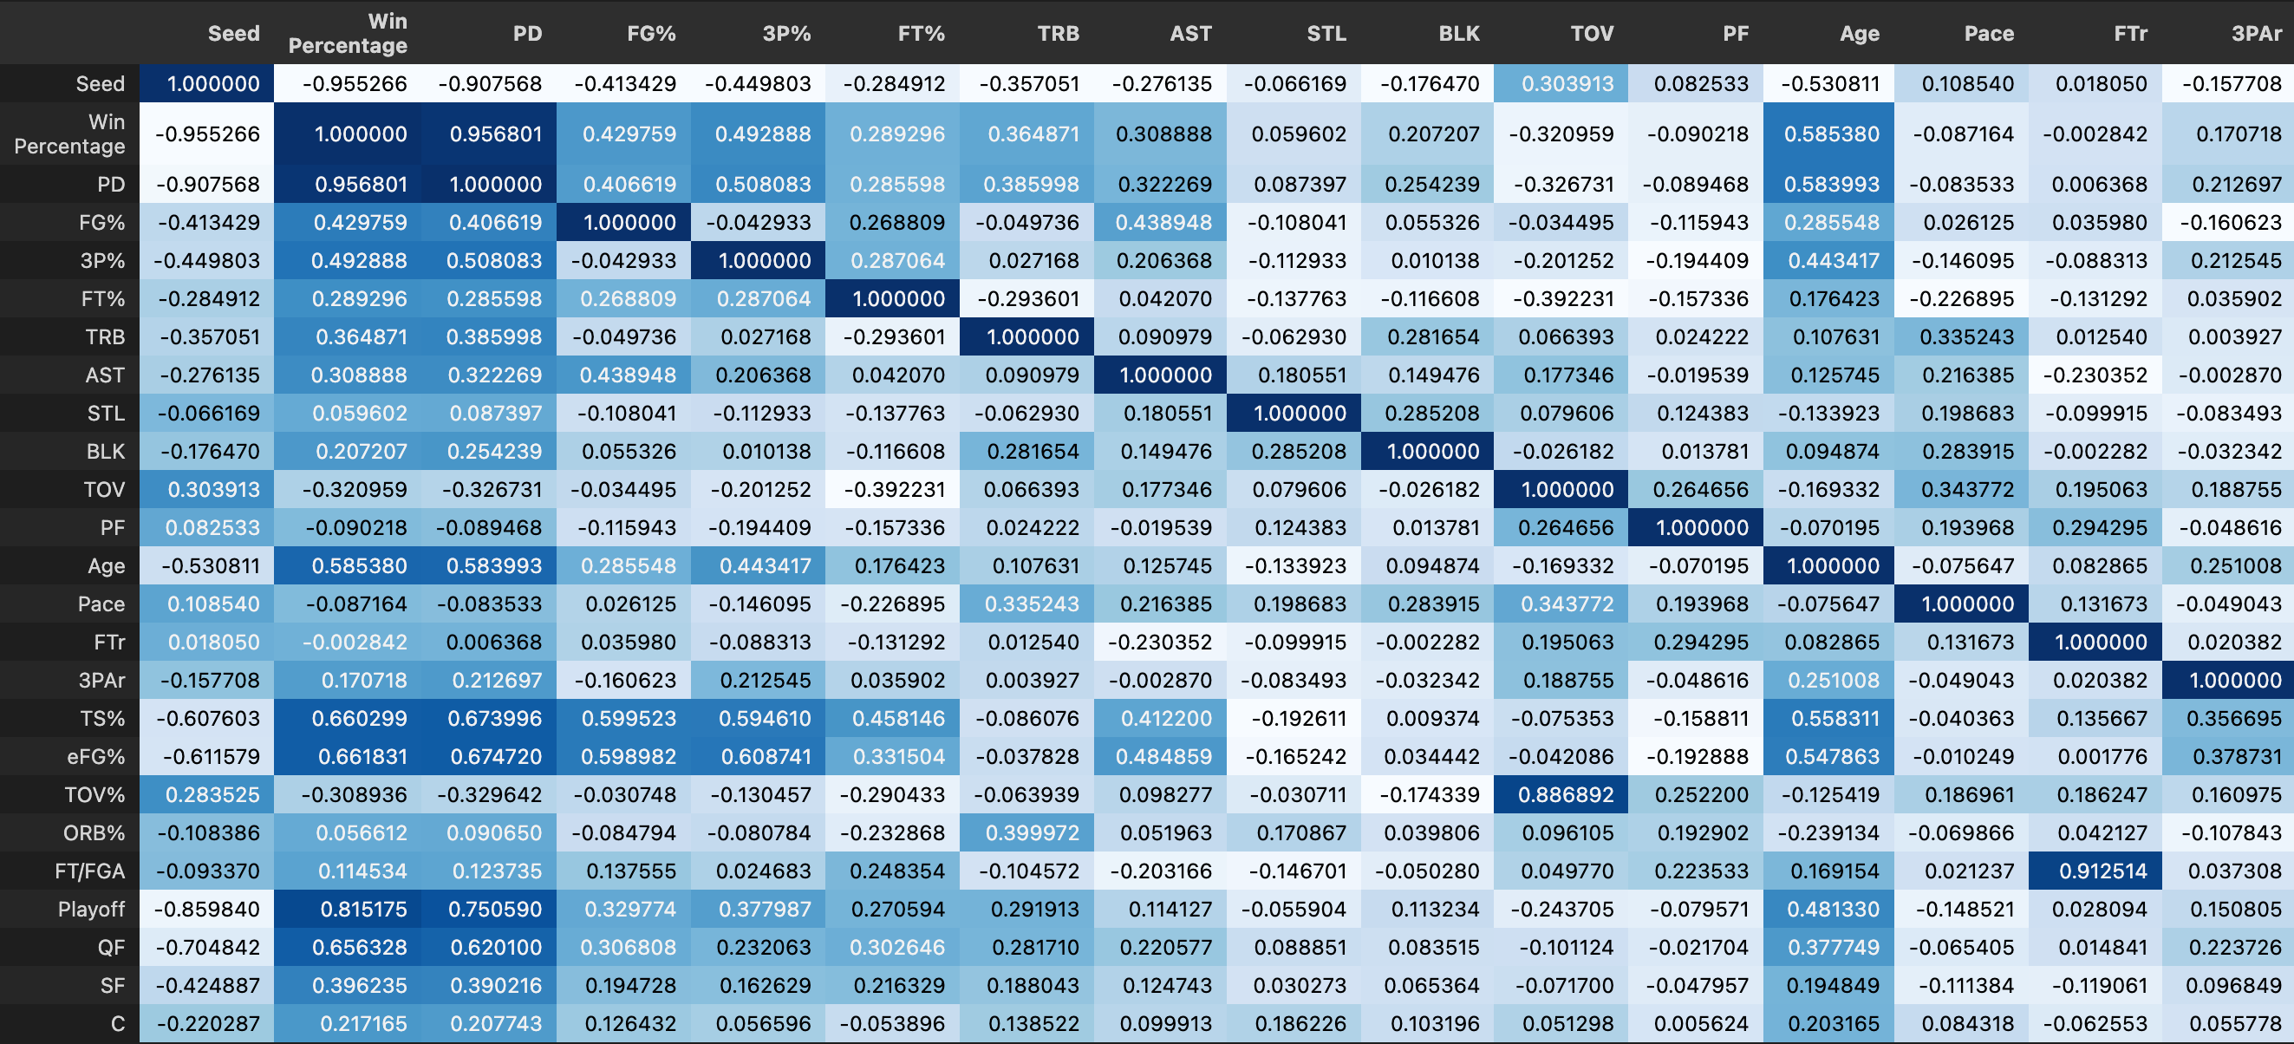
Heatmap
Using this heatmap helped me find the correlations across all variables
Notice the darker blues for the Win percentage, PD, and age columns
I chose to investigate the latter

Slide 16
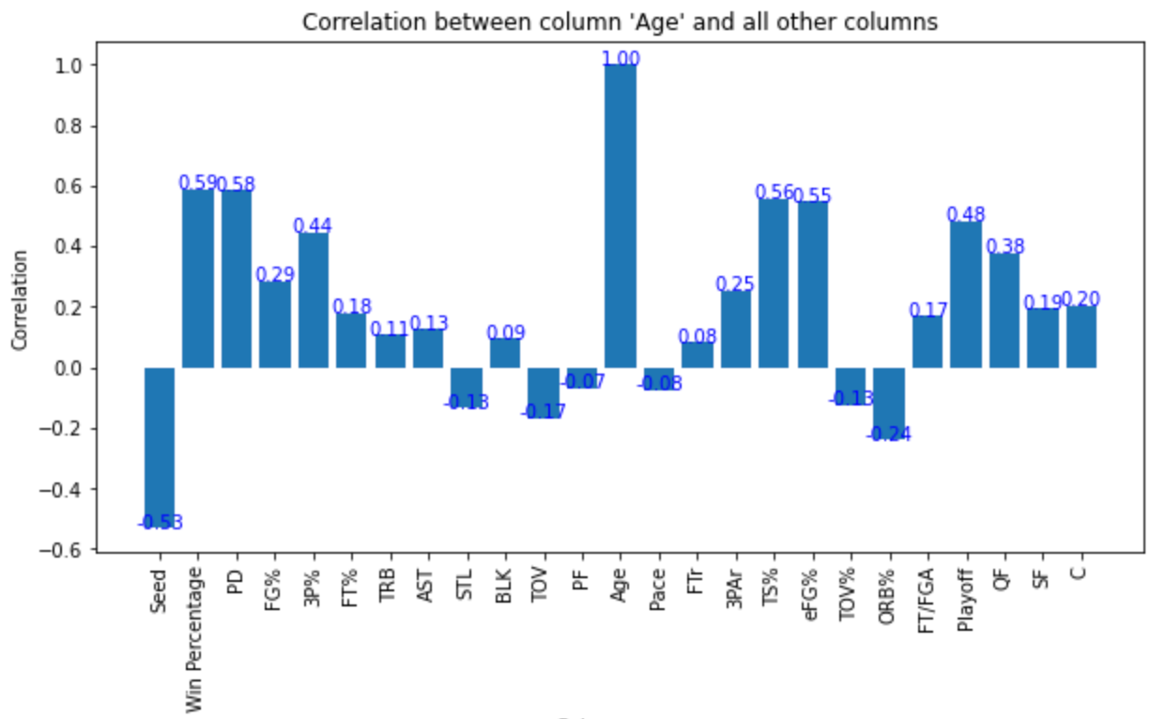
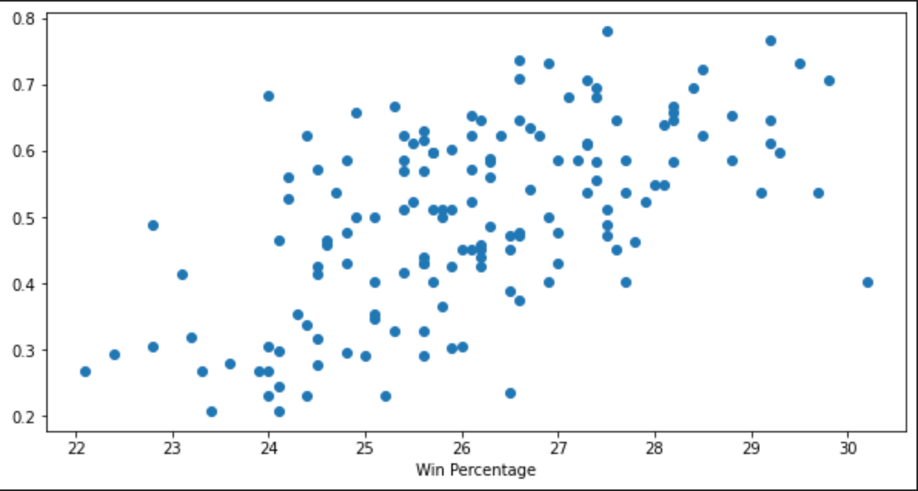
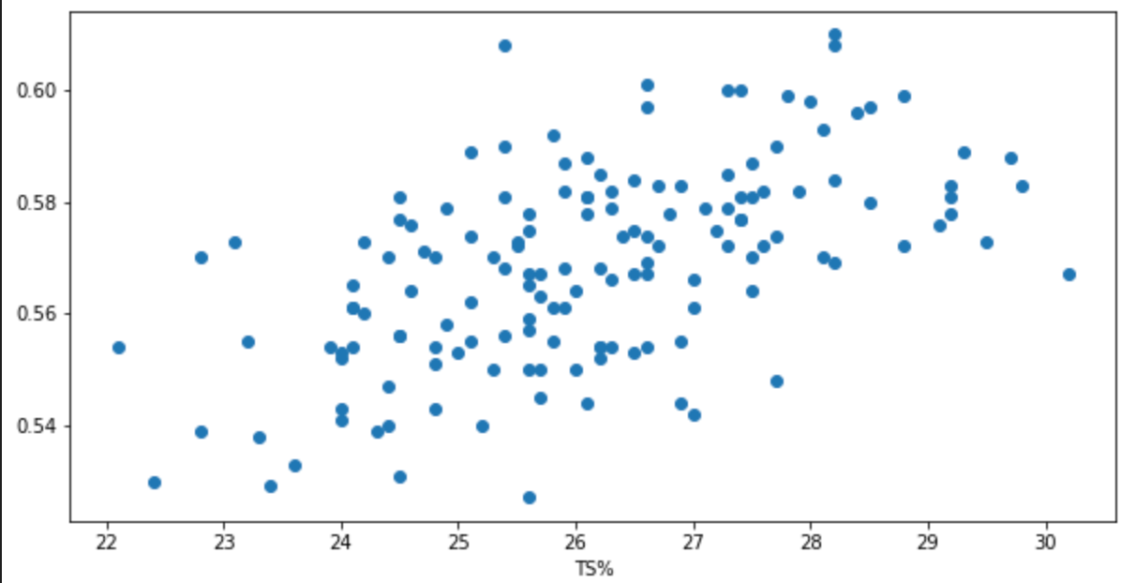
Age Correlations
I thought this was very interesting. Age ~ Win Percentage have a 0.59 correlation and age ~ true shooting percentage have a 0.56 correlation

Slide 17
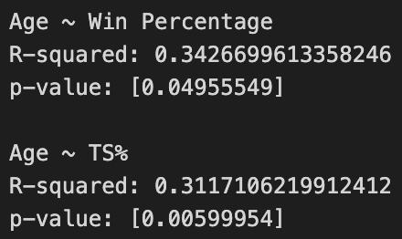
Age Linear Regression
I regressed age onto both these variables and captured the R-squared and p-values
Both p-values are statistically significant at the 0.05 level indicating that they are related in the population
R-squared is around 0.31-0.34 indicating that 31%-34% of win percentage/TS% can be explained by age
There are likely other variables impacting win percentage/TS%

Slide 18
In Conclusion…
I was able to test and train my first random forest and xgboost models
Create python functions that will carry over to other projects
Create feature importance related to each model
Discover correlations across variables

